Slide 1
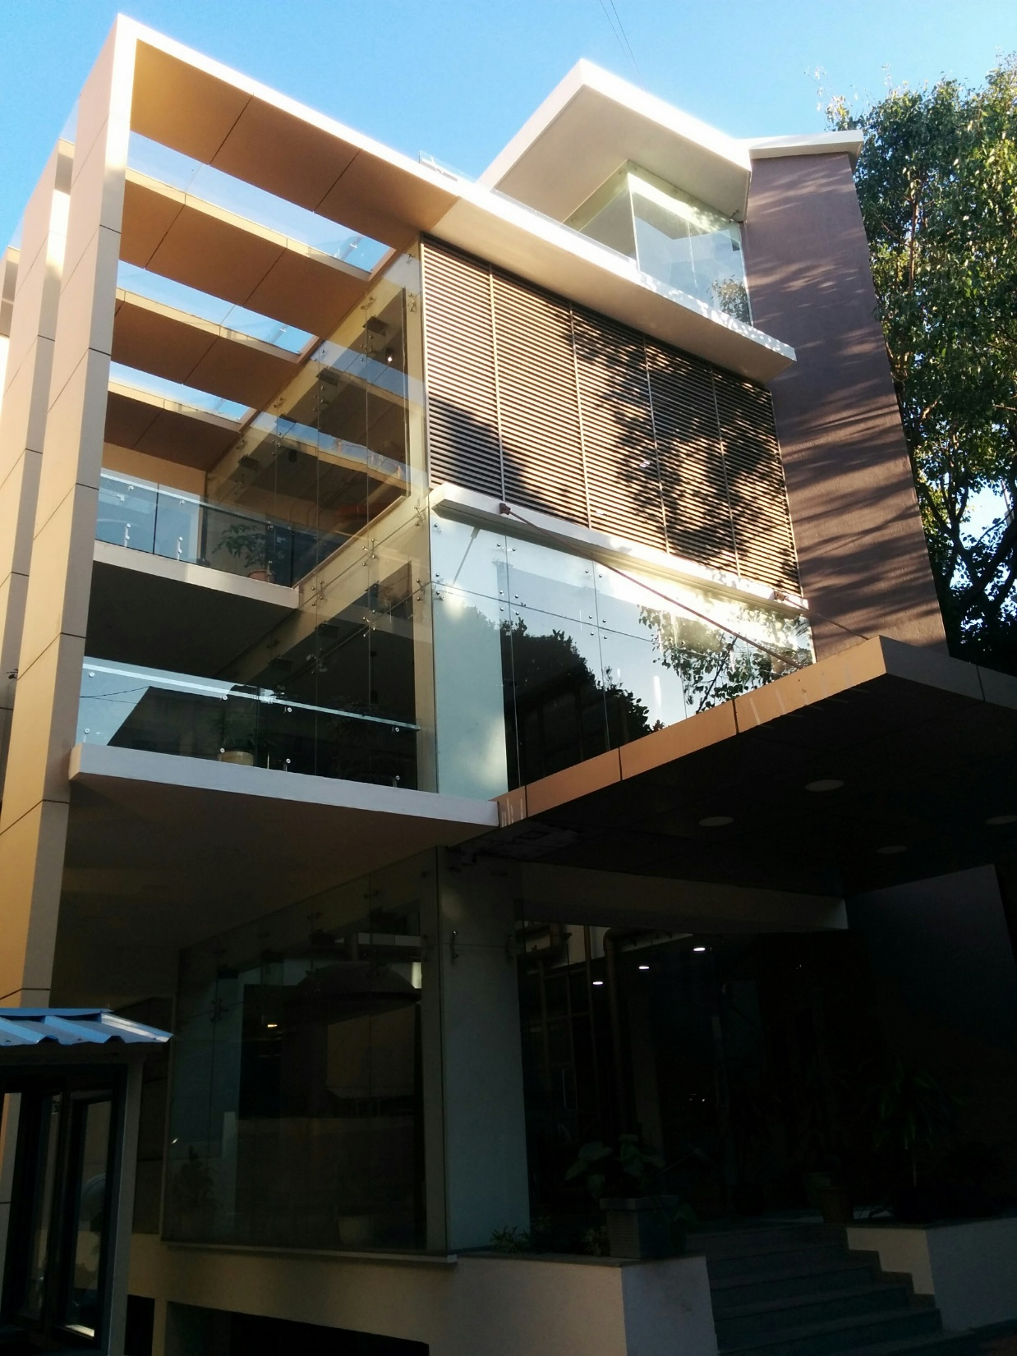

GAC Hackathon
3-5 February 2017

Slide 2
Agenda
Welcome from ABinBev
Schedule
Prizes
Judges
The Challenge
The Data
Judging Criteria
Rules
Hackathon.io
Q&A

Slide 3
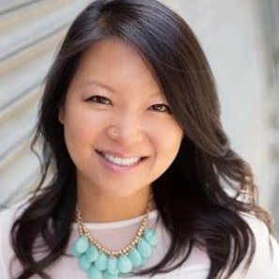
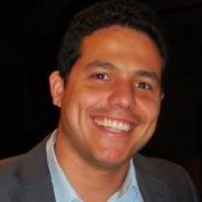
Welcome from ABInBev
Felipe Aragao
Global Growth Analytics Head
Anheuser-Busch InBev
Tina Wung
Global Director, Innovation Community
Anheuser-Busch InBev

Slide 4
Hackathon Schedule
Friday
Saturday
Sunday
6:00PM: Doors Open, Registration
7:00PM: Opening Ceremony
8:00PM: Hacking Begins / Release the Datasets! / Dinner
10:00PM: Breakout Tech Sessions
12:00AM: Midnight Snack
Hack through the night!
8:00AM: Breakfast
12:00PM: Lunch
4:00PM: Pitch Workshop
6:00PM: Dinner
12:00AM: Midnight Snack
8:00AM: Breakfast
9:00AM: Submission Deadline
10:00AM: Judging Begins
11:30 AM: Judge Deliberations
12:00PM: Lunch / Snacks
12:30PM: Awards / Closing Ceremony
1:00PM Happy Hour (21+ only)

Slide 5
Prizes
Grand Prize:
Expenses-paid trip to New York City for the winning team to present to ABInBev leadership!
Guaranteed in-person interviews for each member of your team with the GAC leadership team for potential job and/or investment opportunities
2nd Place
Guaranteed in-person interviews for each member of your team with the GAC leadership team for potential job and/or investment opportunities
PS4 (Playstation) for each team member
3rd Place
Guaranteed in-person interviews for each member of your team with the GAC leadership team for potential job and/or investment opportunities
iPad Air for each team member

Slide 6
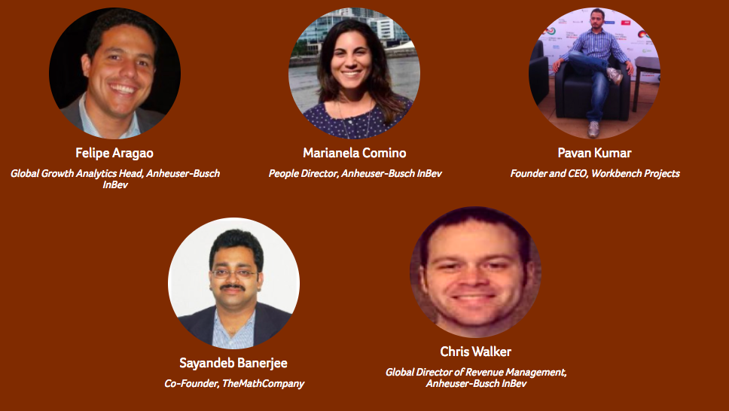
Judges

Slide 7
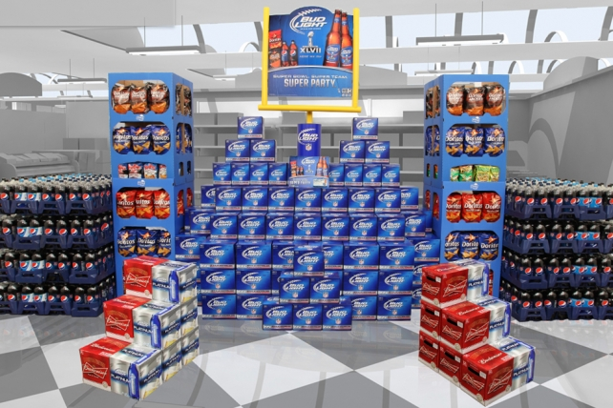
Anheuser-Busch InBev is looking for solutions that help optimize our retail investment.
OVERALL HACKATHON CHALLENGE:
RETAIL OPTIMIZATION BRIEF
In your local liquor stores or supermarkets, in the beer aisle you see rows upon rows of beer stacked into perfect displays
These displays have many price promotions and marketing messages to encourage consumers to purchase ABInBev products!
ABI invests a lot of money in retail promotions to obtain optimal shelf space, displays, price promotions, and featured placements where legal
Our goal is to increase consumer willingness to pay, resulting in improved market share and revenue.

Slide 8
In this hackathon, we will focus on 3 key areas of retail optimization.
Focus Area 1: Driver Analysis
Focus Area 2: Data Visualization
Focus Area 3: Image Processing
Participants have the flexibility to choose either or all of the three focus areas

Slide 9
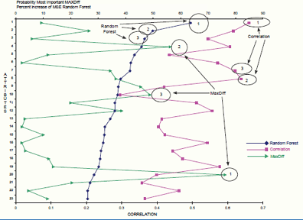
Focus Area 1: Driver Analysis
PROBLEM BRIEF
It’s very complex to identify the specific factors that truly drive incremental volume, market share, and revenue growth.
ABI needs better insights to understand which promotional levers provide the best return on investment.
CHALLENGE
Participants must develop a driver model that quantifies impact of key drivers on sales, share, or volume.

Slide 10
Focus Area 1: Driver Analysis
EXPECTED OUTCOME
Capture impact of changes in price over sales across time
Data modeling to quantify performance drivers for sales, share, or volume lift
Build a tool or interface to support data visualization for better understanding of key insights
AVAILABLE DATA
Weekly product level sales data for whole beer category in a single market for 4 years
Datasets in excel or csv form that will contain a variety of internal & external variables. These will include CPI, GDP growth, product distribution, weather, price and more as well as sales volumes/units

Slide 11
Driver Analysis Sample Data: Internal (Retail) and External Factors data
Date | BRAND | Package Value | BREWER | Segment Value | AB Segment Value | AB Sub-segment Value | AB Mega-segment Value | Distribution (%) | Price per Unit | Price per Volume | Unit Sales | Volume Sales
1/6/2013 | BRAND130 | 6-PACK 11.2-13 OZ GLASS | ABI | CRAFT/IMPORT | HE BEER | IMPORT | ABOVE CORE | 36.9% | $ 10.1 | $ 43.1 | 1,817 | 424
1/13/2013 | BRAND130 | 6-PACK 11.2-13 OZ GLASS | ABI | CRAFT/IMPORT | HE BEER | IMPORT | ABOVE CORE | 37.8% | $ 10.4 | $ 44.4 | 1,726 | 403
1/20/2013 | BRAND130 | 6-PACK 11.2-13 OZ GLASS | ABI | CRAFT/IMPORT | HE BEER | IMPORT | ABOVE CORE | 38.4% | $ 10.1 | $ 43.2 | 2,088 | 487
1/27/2013 | BRAND130 | 6-PACK 11.2-13 OZ GLASS | ABI | CRAFT/IMPORT | HE BEER | IMPORT | ABOVE CORE | 38.9% | $ 10.0 | $ 42.9 | 2,048 | 478
2/3/2013 | BRAND130 | 6-PACK 11.2-13 OZ GLASS | ABI | CRAFT/IMPORT | HE BEER | IMPORT | ABOVE CORE | 40.3% | $ 10.0 | $ 42.7 | 2,231 | 520
Date | Mean Temperature (C) | Max Temperature | Min Temperature | Occupancy (%) | Per Capita Personal Income (Annual) | Labor Force | Employment | Unemployment | Unemp. Rate | …
1/6/2013 | 12 | 17 | 7 | 69.6% | $ 47,580 | 4,945,000 | 4,439,700 | 505,300 | 10.2% | …
1/13/2013 | 13 | 20 | 5 | 69.6% | $ 47,580 | 4,945,000 | 4,439,700 | 505,300 | 10.2% | …
1/20/2013 | 18 | 24 | 11 | 69.6% | $ 47,580 | 4,945,000 | 4,439,700 | 505,300 | 10.2% | …
1/27/2013 | 14 | 19 | 8 | 69.6% | $ 47,580 | 4,945,000 | 4,439,700 | 505,300 | 10.2% | …
2/3/2013 | 13 | 18 | 9 | 75.3% | $ 47,580 | 4,948,900 | 4,446,700 | 502,200 | 10.1% | …

Slide 12
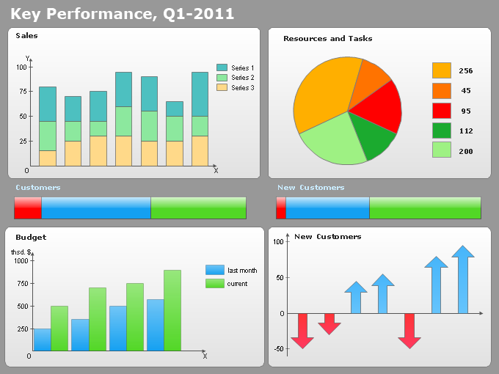
Focus Area 2: Data Visualization
PROBLEM BRIEF
ABI has a significant amount of data in formats that are not easily readable or digestible for the end user.
ABI’s raw data is necessary for analytics, but the insights that the data uncovers is much more important.
ABI must use the insights from the data to make better decisions on how to invest our money in retail promotions.
CHALLENGE
Participants can enhance their driver analysis solution’s desirability by supporting it with a tool or interface which will help business users leverage insights from the data model. Participants must develop an elegant data visualization solution in order to extract the retail insights that will allow us to implement better retail promotion strategy and tactical activation.

Slide 13
Focus Area 2: Data Visualization
EXPECTED OUTCOME
Post-Event tool: A tool which will help business users identify which actions drive incremental sales, share, or revenue for each product during a specific time frame and which do not. The flow of the tool should be intuitive and in a self-servicing format.
Scenario planner: A ‘What-If-Analysis’ tool which will help business users determine promotional prices and display & feature ads for products to optimize sales in future
SUGGESTIONS FOR SUCCESS
Include graphs for representing key business insights
Support dynamic and interactive graphs which can take user inputs (eg D3.js, PykCharts.js, etc.)
Open Source platforms which are scalable to support implementation in business environment
AVAILABLE DATA
Same data as provided for Focus Area 1 – Driver Analysis

Slide 14
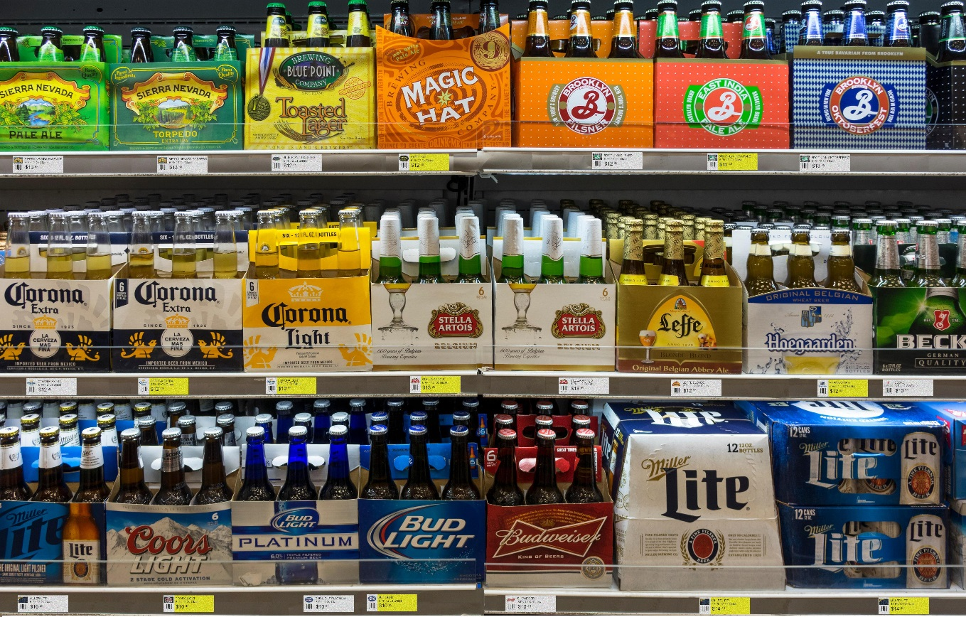
Focus Area 3: Image Processing
PROBLEM BRIEF
ABI recommends retailers to sell our products at specific prices
But retailers can deviate from the recommended prices which can reduce ABI product sales
Due to retailers’ different pricing strategy or manual errors
At times, the price tags are not placed with corresponding beer pack
ABI has a clear need to routinely monitor recommended prices in market
Now collects store shelf images with price tags weekly
CHALLENGE
Participants must develop an algorithm to extract the weekly price of every SKU from these shelf images. The algorithm should identify the products and weeks where there is deviation versus recommended price or erroneous product labeling.

Slide 15
Focus Area 3: Image Processing
EXPECTED OUTCOME
Extract and store weekly price of every SKU (stock keeping unit) on the shelf
List of SKUs along with weeks where price is different from recommended price
List of SKUs along with weeks where price tags are placed erroneously
AVAILABLE DATA
Shelf images of products at retail in help showcase the real life scenarios for 104 weeks
ABI recommended SKY price list for 104 weeks

Slide 16
Image Processing Sample Data: Shelf Set Image

Slide 17
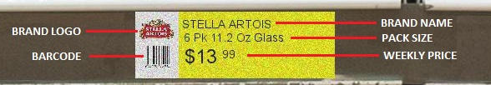
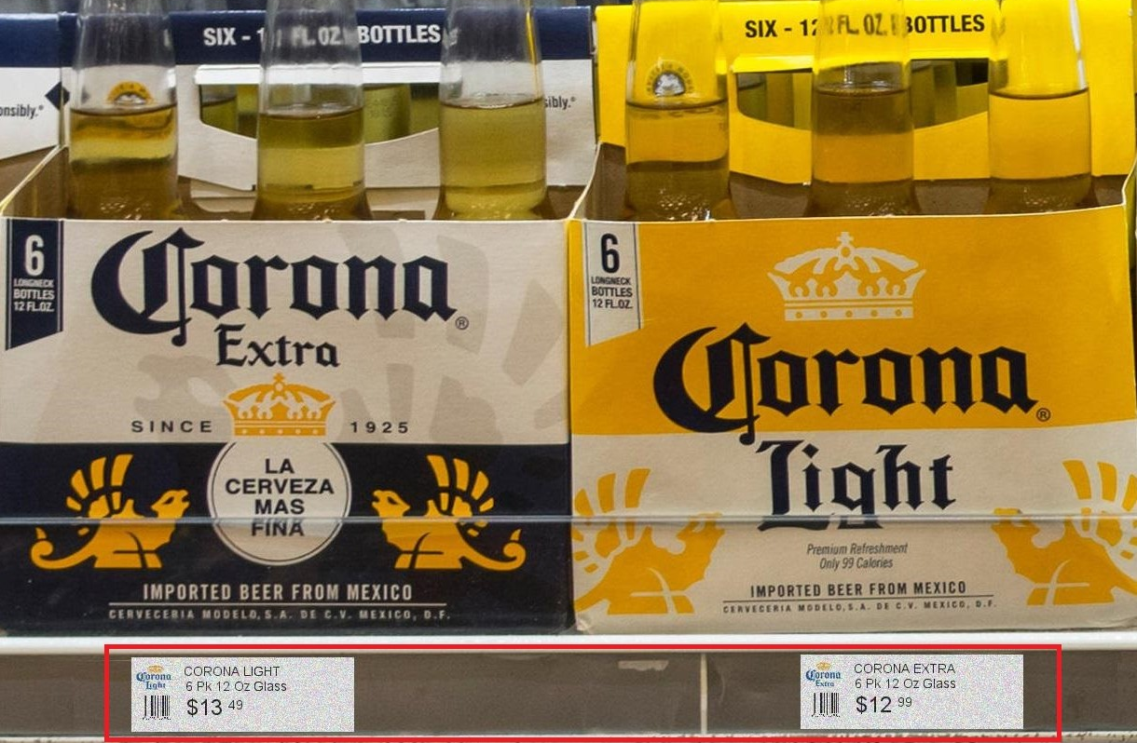
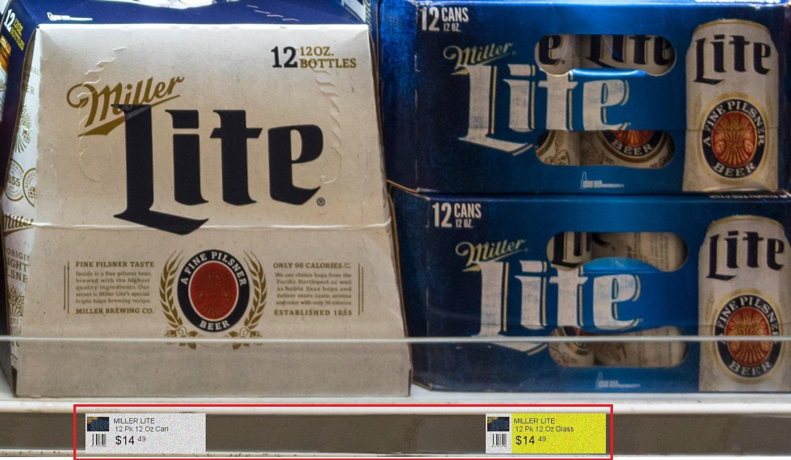
Image Processing Sample Data: Price Tags

Slide 18
Judging Criteria
40% for technical execution and approach
Robustness of algorithm
Coding best practices
30% for the desirability and feasibility
Desirability – will the end users want to use it?
Feasibility – is this solution something that the end users can implement at scale?
30% for innovation and uniqueness

Slide 19
Rules
Max Team Size = 5
Submissions due on Hackathon.io @ 9am Sunday, February 5
2 minutes to Demo, 1 minute for Judge Q&A
Participation Agreement
Fresh Code
Code of Conduct
Travel Stipends
Registration & Check-In – Arrive Early!

Slide 20
Hackathon.io
Go to: http://www.hackathon.io/abinbev-hacktheworld-bangalore/
Click on “Join Event”
Click on “Projects”
Click on “List Your Project”
Click “Proceed”
Check ”Projects” to confirm you’re listed!

Slide 21
Q&A

